Slide 1

ML and Linear Regression
By:
Dr. G G Md Nawaz Ali
E-mail: nali@fsmail.Bradley.edu
Slide courtesy:
Dr. Babu K. Baniya
Pierian Data

Slide 2
Machine Learning (ML)
ML is a subfield of artificial intelligence that involves the development of algorithms and statistical models that enable computers to improve their performance in tasks through experience.
These algorithms and models are designed to learn from data and make predictions or decisions without explicit instructions.
There are several types of machine learning:
Supervised learning
Unsupervised learning
Semi-supervised learning
Reinforcement Learning

Slide 3
Supervised Learning
Supervised learning is the machine learning task of learning a function that maps an input to an output based on example input-output pairs.
The algorithms to predict the outcome as accurate as possible.
Example — Consider the following data regarding patients entering a clinic.
The data consists of the gender and age of the patients and each patient is labeled as “healthy” or “sick”.

Slide 4
Supervised Learning
No | Attribute1 (gender) | Attribute2 (age) | Class (label)
1 | M | 49 | sick
2 | M | 64 | sick
3 | F | 55 | healthy
4 | M | 48 | sick
5 | F | 34 | healthy
6 | F | 25 | healthy
8 | M | 24 | healthy
The labelled datasets make the algorithms understand the relationship among the datasets and carry out classification or prediction as a new outcome quickly with utmost accuracy.
Table 1: Example of supervised learning

Slide 5
Supervised Learning
Different Approaches of Supervised Learning
Classification − In this approach, algorithms are trained to categorize the data into distinct units depending on their labels.
Examples of some classification algorithms are − Logistic regression, Decision Tree, Random Forest, Support Vector Machine, etc. Classification can be of types Binary and Multi-class.
Regression − This approach makes a computer program understand the relationship between dependent and independent data.
Once training the algorithm is completed, the algorithm can predict the future values easily.
Examples: Some popular regression algorithms are Linear, and Polynomial regression.

Slide 6
Classification and Regression Algorithms
Difference between Classification and Regression Algorithms:
The prominent difference between Classification and Regression algorithms is that the Regression algorithms are used to predict continuous values such as height, weight, cost, salary, weather, etc.
In contrast, the Classification algorithms are used to classify or predict discrete values such as True or False, Valid or Invalid, Yes or No, Spam or Not Spam, Male or Female, etc.

Slide 7
Unsupervised Learning
The unsupervised learning approach of machine learning does not use labelled datasets for training the algorithms.
Instead, the machines learn on their own by accessing massive amount of unclassified data and finding its implicit patterns.
The algorithms analyze and cluster the unlabeled datasets.
There is no human intervention required while analyzing and clustering hence the name "Unsupervised".

Slide 8
Unsupervised Example
No | Attribute1 (gender) | Attribute2 (age)
1 | M | 49
2 | M | 64
3 | F | 55
4 | M | 48
5 | F | 34
6 | F | 25
8 | M | 24
Table 2: Example of unsupervised learning

Slide 9
Unsupervised Learning
The unsupervised learning approach is of the following three types:
Association: This approach uses some rules to find relationships between variables in a dataset.
This approach is often used in suggestions and recommendation.
For example, suggesting an item to a customer with: "The customers who bought this item also bought", or "You may also like", or simply by showing allied product images and recommending to buy related items.
For example, when the primary product being purchased is a computer, then suggesting to buy a wireless mouse and a remote keyboard too.
Clustering: It is a learning technique in data mining where unlabeled or unclassified data are grouped depending on either similarities or differences among them.

Slide 10
Unsupervised Learning
Dimensionality Reduction − It is a learning technique used to reduce the number of random variables or ‘dimensions’ to obtain a set of principal variables, when the number of variables is very high.
This technique helps data compression without compromising the usability of the data.

Slide 11
Why Unsupervised Learning
Unlabeled, uncategorized data is available in abundance.
Unsupervised learning can explore unknown patterns of data.
Labelling the data is a tedious task, which also can allow human errors in Supervised learning, which is not the case with unsupervised learning.

Slide 12
Supervised and Unsupervised Learning
Supervised Learning | Unsupervised Learning
The datasets used in Supervised learning are labelled. | The data used in Unsupervised learning are unclassified.
The classes of data are known. | The number of classes is unknown as the model data is uncategorized and unlabeled.
In supervised learning, human intervention is required to label the data appropriately. | The unsupervised learning makes the algorithm to take care of both; the input and the output of the data analyzing but human intervention is only required for data validation.
It is simple and inexpensive (in term of computational cost). | It is complicated, time-consuming, and requires more resources (in term of computational cost).
It provides highly accurate outcome. The accuracy can be hampered only if the experts who are labelling the datasets didn’t label them appropriately | Unsupervised learning is less accurate.

Slide 13
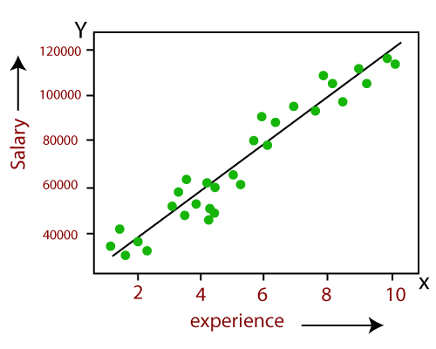
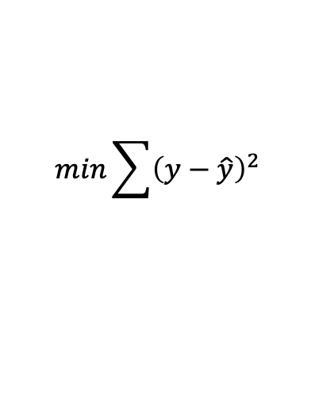
Linear Regression
*Linear regression analysis is used to predict the value of a variable based on the value of another variable(s).
The variable you want to predict is called the dependent variable.
The variable (s) you are using to predict the other variable's value is called the independent variable.
Linear regression models are relatively simple and easy to implement.
y=mx+c
#m is slope, c-intercept
$$min\sum{{\left(y−\hat{y}\right)}^{2}}$$
dependent variable
independent variable

Slide 14
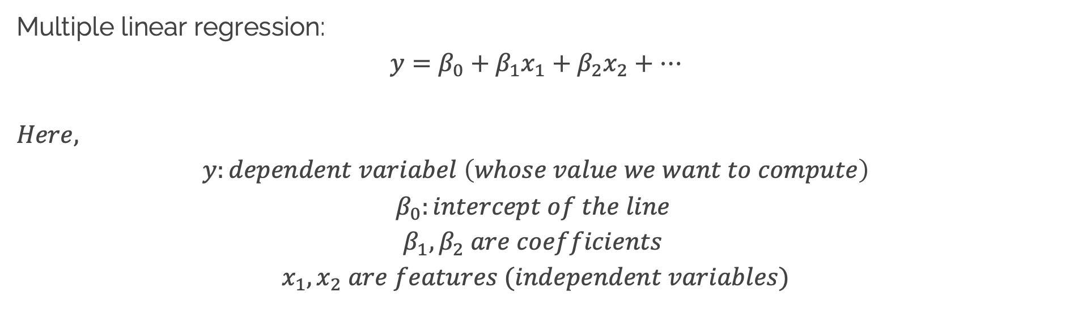
Linear Regression (cont.)
Multiple linear regression:
$$y=β_{0}+β_{1}x_{1}+β_{2}x_{2}+…$$
$$Here,$$
$$y:dependent variabel \left(whose value we want to compute\right)$$
$$β_{0}:intercept of the line$$
$$β_{1}, β_{2} are coefficients$$
$x_{1},x_{2} are features (independent variables)$

Slide 15
Evaluating Performance
REGRESSION

Slide 16
Evaluating Regression
Regression is a task when a model attempts to predict continuous values (unlike categorical values, which is classification)

Slide 17
Evaluating Regression (cont.)
accuracy or recall metrics aren’t useful for regression problems, we need metrics designed for continuous values!

Slide 18
Evaluating Regression (cont.)
For example, attempting to predict the price of a house given its features is a regression task.
Attempting to predict a house in which country it belongs would be a classification task.

Slide 19
Evaluating Regression (cont.)
Let’s discuss some of the most common evaluation metrics for regression:
Mean Absolute Error
Mean Squared Error
Root Mean Square Error
Refs:
https://towardsdatascience.com/evaluation-metrics-model-selection-in-linear-regression-73c7573208be

Slide 20
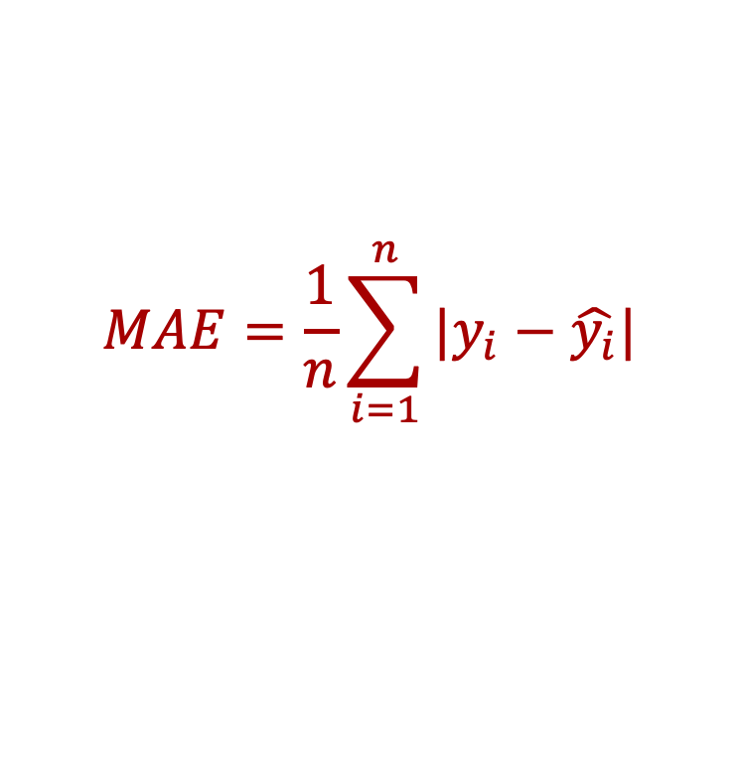
Evaluating Regression (cont.)
Mean Absolute Error (MAE)
This is the mean of the absolute value of errors.
Easy to understand
$$MAE=\frac{1}{n}\sum_{i=1}^{n}{|y_{i}−\hat{y_{i}}|}$$

Slide 21
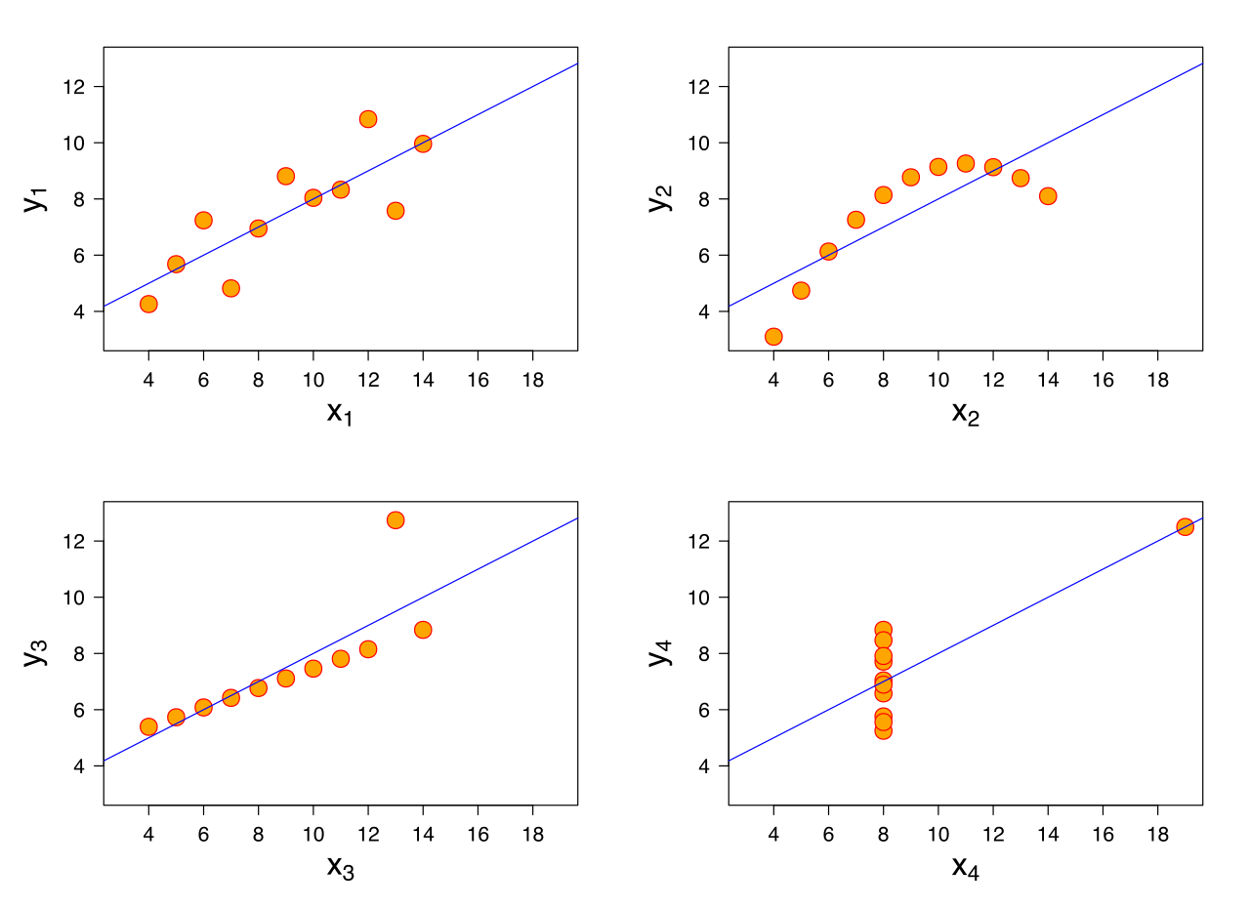
Evaluating Regression (cont.)
However, MAE doesn’t punish large errors.
Fig ref.: pierian data

Slide 22
Evaluating Regression (cont.)
We want our error metrics to account for these!
Fig ref.: pierian data

Slide 23
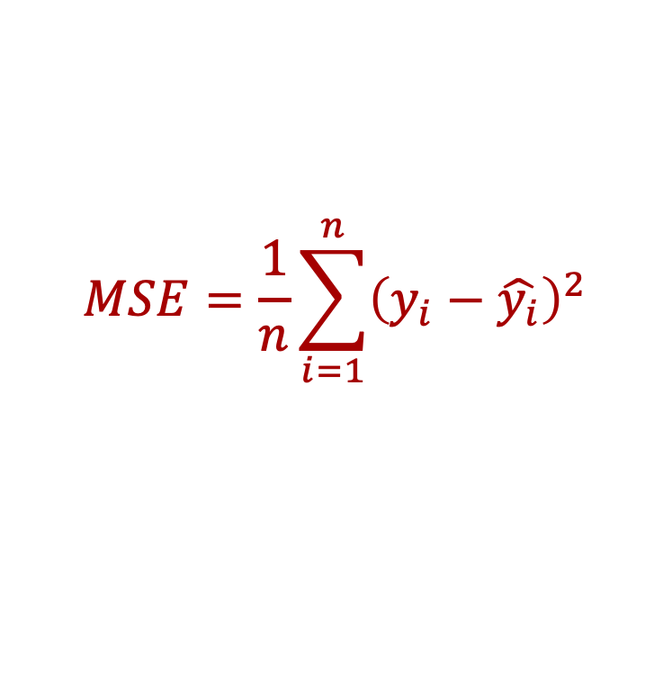
Evaluating Regression (cont.)
Mean Squared Error (MSE)
This is the mean of the squared errors.
Larger errors are noted more than with MAE, making MSE more popular.
$$MSE=\frac{1}{n}\sum_{i=1}^{n}{{\left(y_{i}−\hat{y_{i}}\right)}^{2}}$$

Slide 24
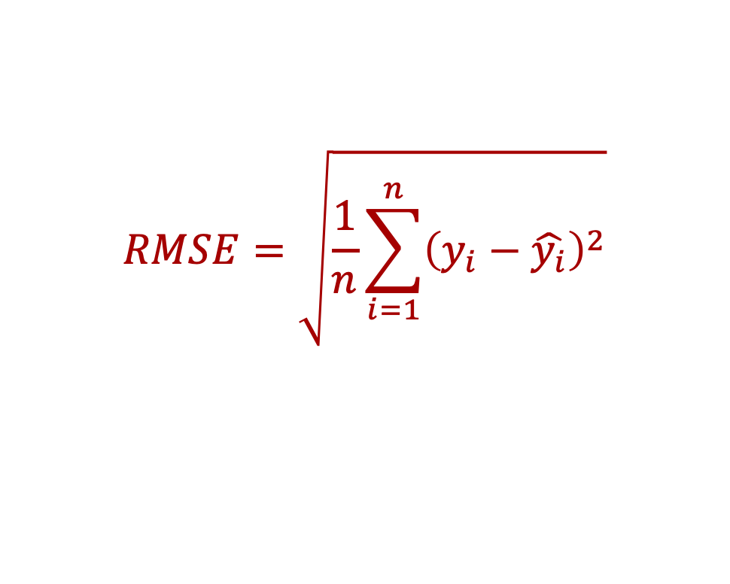
Evaluating Regression (cont.)
Root Mean Square Error (RMSE)
This is the root of the mean of the squared errors.
Most popular (has same units as y)
$$RMSE=\sqrt{\frac{1}{n}\sum_{i=1}^{n}{{\left(y_{i}−\hat{y_{i}}\right)}^{2}}}$$

Slide 25
Evaluating Regression (cont.)
Which RMSE value is good enough?
Context is everything!
A RMSE of $100 is fantastic for predicting the price of a house even for $1,000, but just $10 RMSE is bad for buying an orange!

Slide 26
Evaluating Regression (cont.)
Compare your error metric to the average value of the labeled data to get an intuition of its overall performance.
Domain knowledge also plays an important role here!

